Slide 1
BigTable and Google DataStore

Slide 2
BigTable
Physically sorted on row-key – like a row-store
Column families - like column-stores
Variable (record-by-record) columns within a column family
Column-values versioned; stored in reverse chronological order
Designed to store hyperlink structure of web

Slide 3
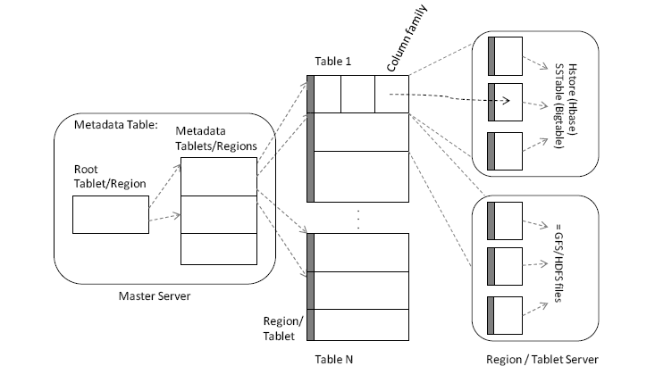
BigTable Storage
Also:
Chubby lock-manager manager used to store location of root, column-families per-table, access-control lists etc. and ensure atomic access to such informations

Slide 4
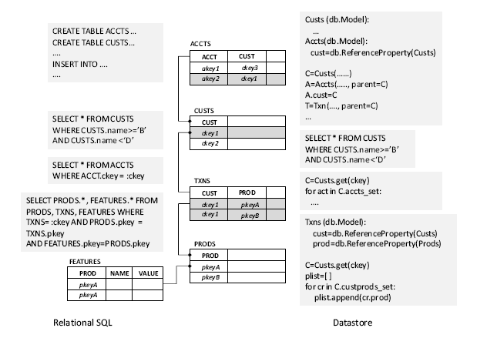
Google Data Store - recap
entity groups
range queries

Slide 5
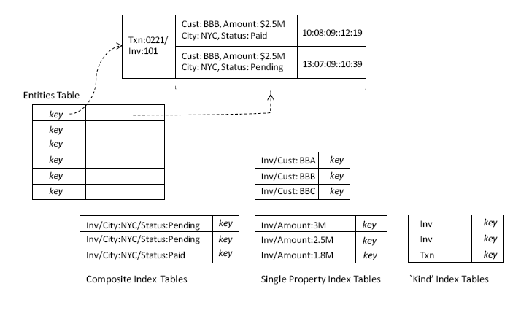
Google Datastore in BigTable
z
View the Entities BigTable as a sharded array sorted lexicographically by key values
Most indexes created automatically by GAE when queries are run for the first time
Certain indexes, such as composite indexes, need to be specified by developers

